Slide 1
MXLib2019 Jenkins Config Guide
YD Chiang
2019/01/12

Slide 2
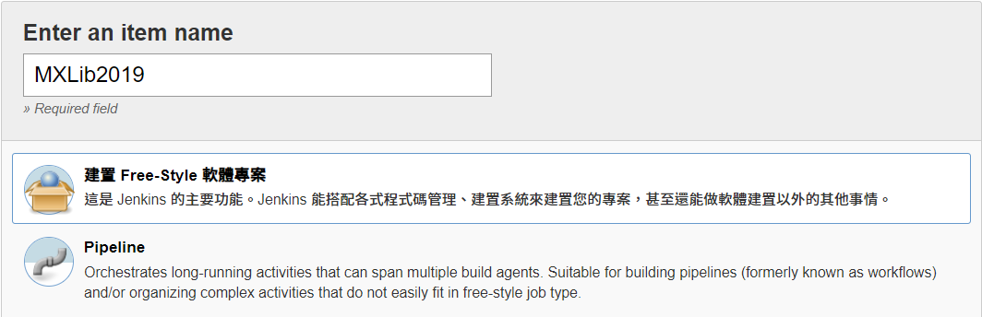
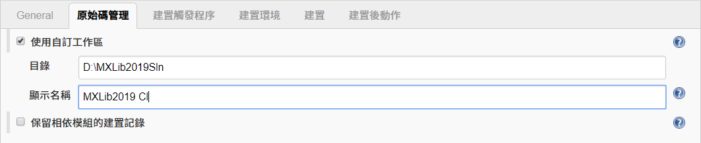
建立新Jenkins作業

Slide 3
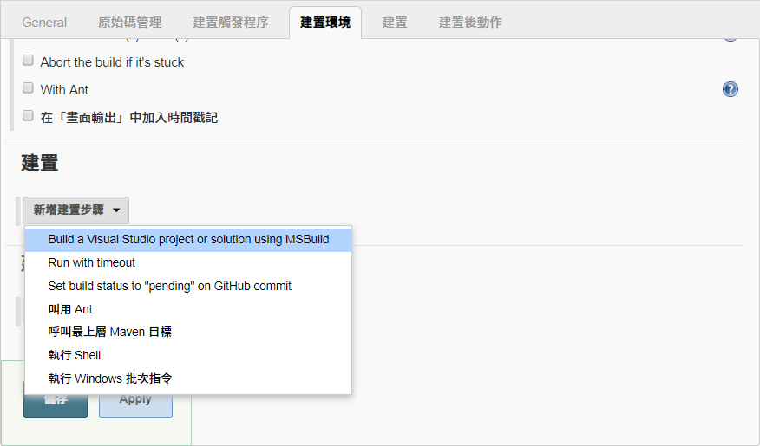
新增建置步驟

Slide 4
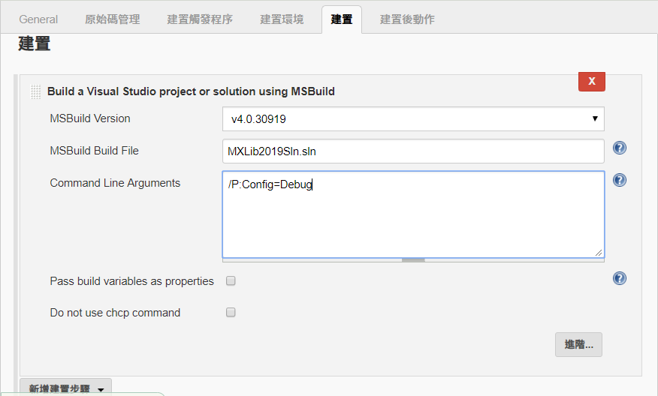
設定MSBuild參數

Slide 5
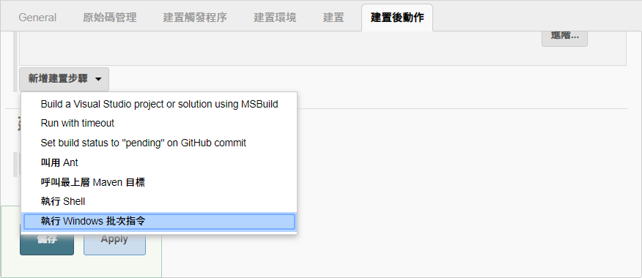
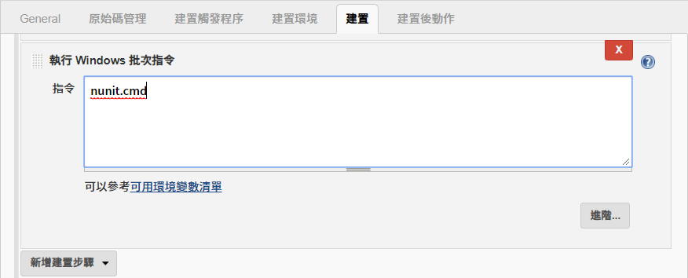
設定建置後執行寫好的NUnit指令

Slide 6
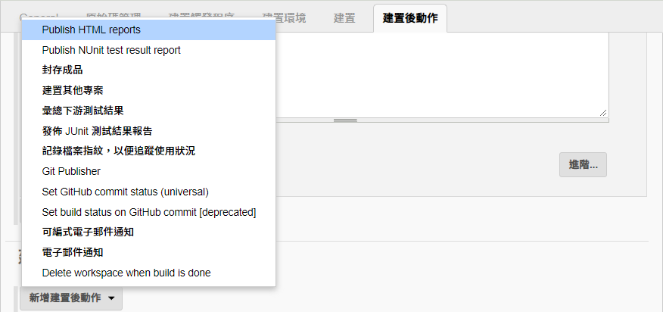
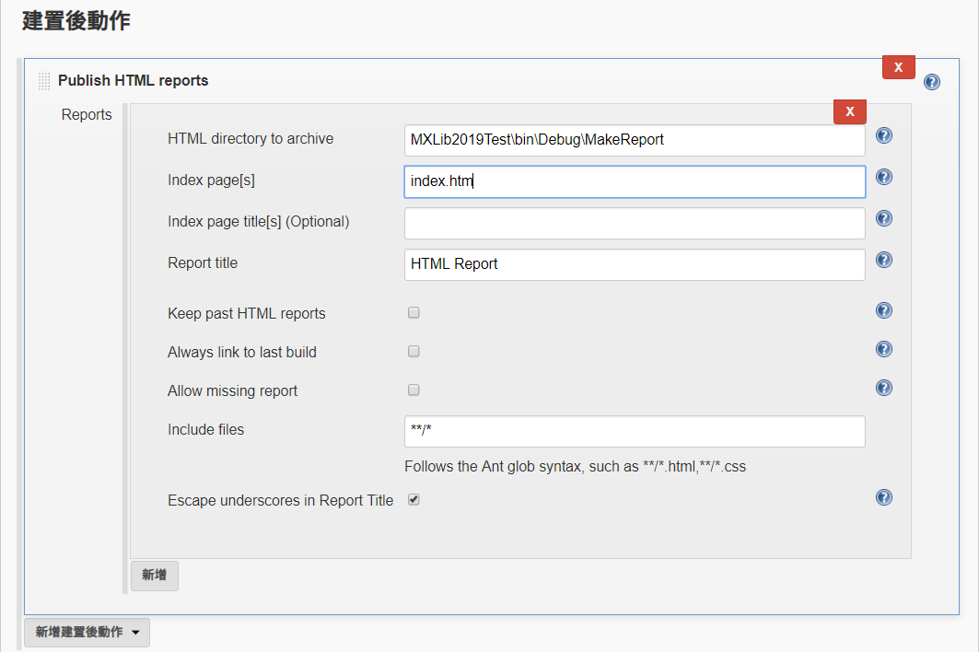
設定發佈Code coverage HTML Report
注意延伸檔名為 htm

Slide 7
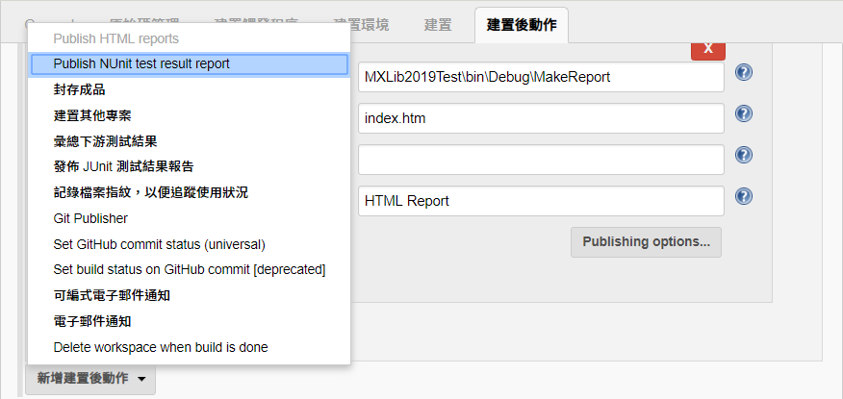
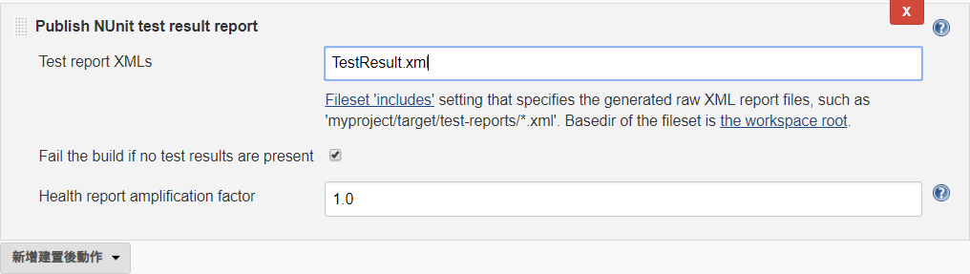
設定發佈Nunit測試結果報告

Slide 8
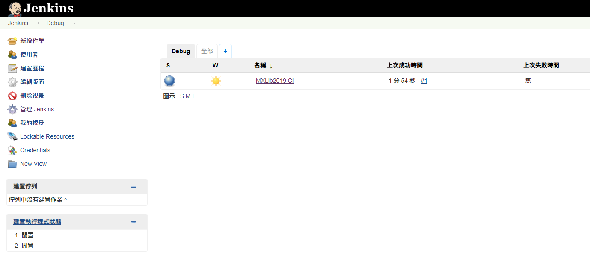
完成Jenkins作業設定

Slide 9
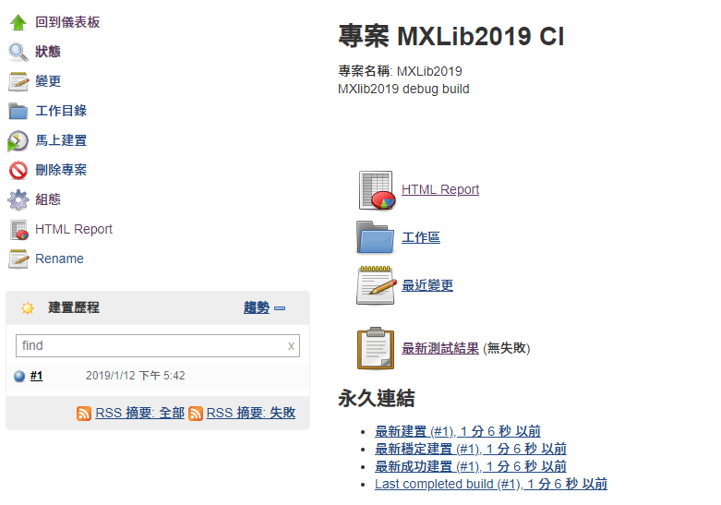
建置完成

Slide 10
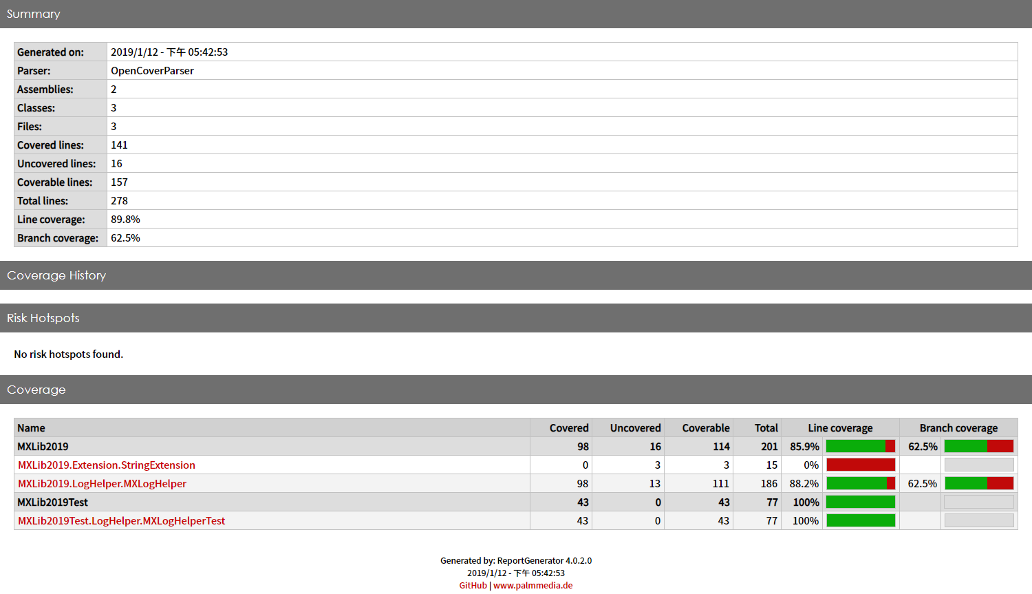
Code Coverage Report

Slide 11
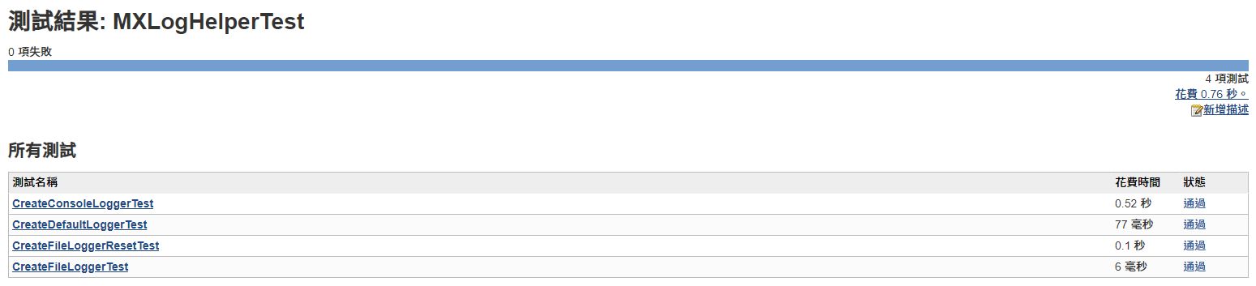
測試結果報告

Slide 12
Plugins
MSBuild Plugin 1.29 This plugin makes it possible to build a Visual Studio project (.proj) and solution files (.sln).
NUnit plugin 0.23 This plugin transforms NUnit test reports so they can be recorded by Jenkins' JUnit features.
HTML Publisher plugin 1.17 This plugin publishes HTML reports.

